Slide 1
Annual Operating Plan
Citi Finance
April 6, 2023
Notes:
1

Slide 2
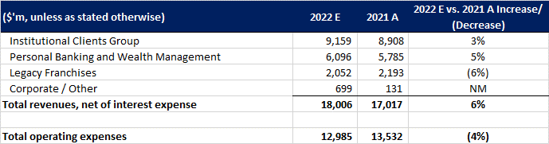
Consolidated Revenue Analysis
Total Revenue: $18,006M (+6% YoY)
Key Drivers:
Interest Rate Benefits: Strong Net Interest Income (NII) growth across all segments. TTS (+36%) and US Personal Banking (+10%) were primary beneficiaries.
Markets Strength: Fixed Income grew 31% due to rates/currencies volatility, offsetting a 14% drop in Equity Markets.
Key Offsets:
Banking Slump: Investment Banking fell 58% due to macroeconomic uncertainty.
Legacy Exits: Revenue fell 6% as 5 international markets closed and Korea/Russia wind-downs continued.

Slide 3
Operating Expenses & Efficiency
Total Expenses: $12,985M (-4% YoY)
Key Drivers:
Legacy Divestitures: Significant drop due to the absence of $1.2B in one-time costs from the prior year.
Cost Control: Corporate/Other expenses fell 23% due to lower consulting spend.
Strategic Investments:
Transformation: Expenses in ICG (+6%) and PBWM (+7%) rose due to multi-year investments in tech, risk, and control environments.
Volume Costs: Higher activity in credit cards and services drove volume-related expense growth.

Slide 4
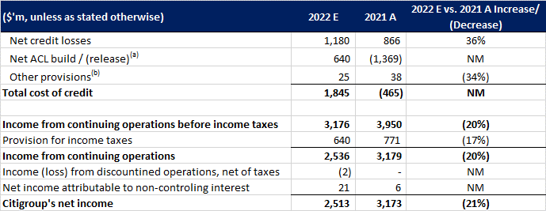
Cost of Credit (Shift in Risk)
Total Cost of Credit: $1,845M (vs. -$465M Benefit in 2021)
Key Drivers:
ACL Build ($640M): A massive swing from 2021’s pandemic-era reserve releases. Driven by PBWM ($752M build) due to card loan growth and deteriorating macro-economic assumptions.
Normalization: Net credit losses rose 36% overall (60% in PBWM) as consumer credit behavior returned to pre-pandemic levels.
Geopolitical Impact: Russia exposure drove ACL movements in ICG, though partially offset by specific direct exposure reductions.
(a) Includes credit reserve build / (release) for loans and provision for credit losses on unfunded lending commitments. (b) Includes provisions for policyholder benefits and claims, HTM debt securities and other assets.

Slide 5
Net Income Summary
Citigroup Net Income: $2,513M (-21% YoY)
Reasons:
Performance vs. Provision: Despite strong top-line revenue growth (+6%) & disciplined expense management (-4%), the bottom line was heavily pressured by the normalization of credit costs.
Business Mix: ICG remains the primary profit engine ($1.9B), while PBWM net income fell 93% ($114M) as it absorbed the brunt of the credit reserve builds.
Recovery: Legacy Franchises and Corporate successfully pivoted from net losses in 2021 to positive income in 2022.

